Slide 1
Xamarin Community Toolkit

Slide 2


Javier Suarez
Gerald Versluis

Slide 4

Xamarin Community Toolkit
The Xamarin Community Toolkit is a collection of common elements for mobile development with Xamarin.Forms that people tend to replicate across multiple apps. It simplifies and demonstrates common developer tasks when building apps with Xamarin.Forms.
The library contains:
Behaviors
Converters
Effects
Views

Slide 5
Behaviors

Slide 6
Behaviors
Behaviors lets you add functionality to user interface controls without having to subclass them. Behaviors are written in code and added to controls in XAML or code.
EmailValidationBehavior
EventToCommandBehavior
NumericValidationBehavior
AnimationBehavior
MaskedBehavior
UriValidationBehavior
RequiredStringValidationBehavior
UserStoppedTypingBehavior
ImpliedOrderGridBehavior
MaxLengthReachedBehavior
CharactersValidationBehavior

Slide 7
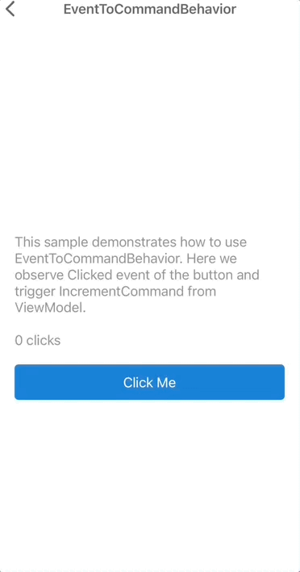
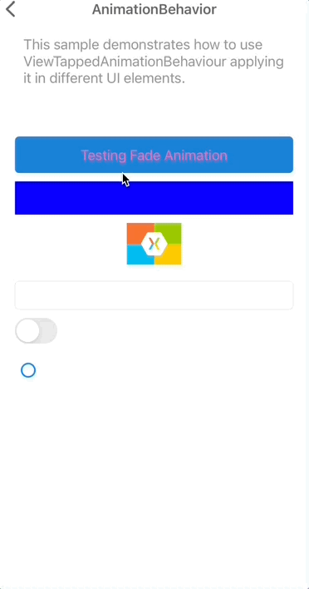
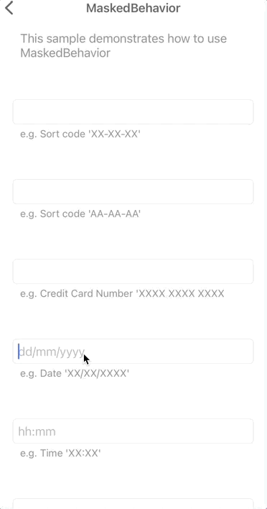
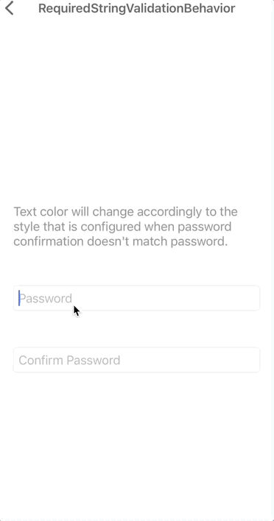
Behaviors

Slide 8
DEMO: Let's take a look at the behaviors

Slide 9
Converters

Slide 10
Converters
Suppose you want to define a data binding where the source property is of type int but the target property is a bool. You want this data binding to produce a false value when the integer source is equal to 0, and true otherwise.
You can do this with a class that implements the IValueConverter creating something you probably know, Converters.
In the XCT, we try to group those common Converters, which are repeated from app to app to simplify the process.
ByteArrayToImageSourceConverter
DateTimeOffsetConverter
ItemSelectedEventArgsConverter
ItemTappedEventArgsConverter
MultiConverter

Slide 11
DEMO: Let's take a look at the converters

Slide 12
Effects

Slide 13
Effects
Effects allow the native controls on each platform to be customized, and are typically used for small styling changes.
Available Effects:
IconTintColorEffect
RemoveBorderEffect
SafeAreaEffect
SelectAllTextEffect

Slide 14
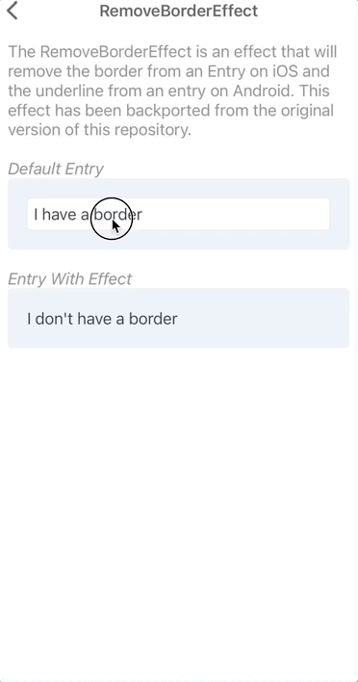
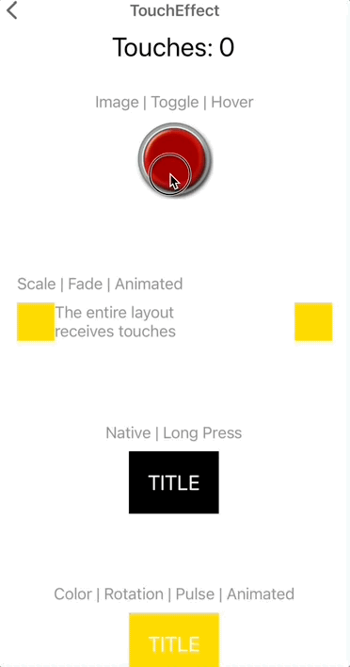
Effects

Slide 15
DEMO: Let's take a look at the effects

Slide 16
Views

Slide 17
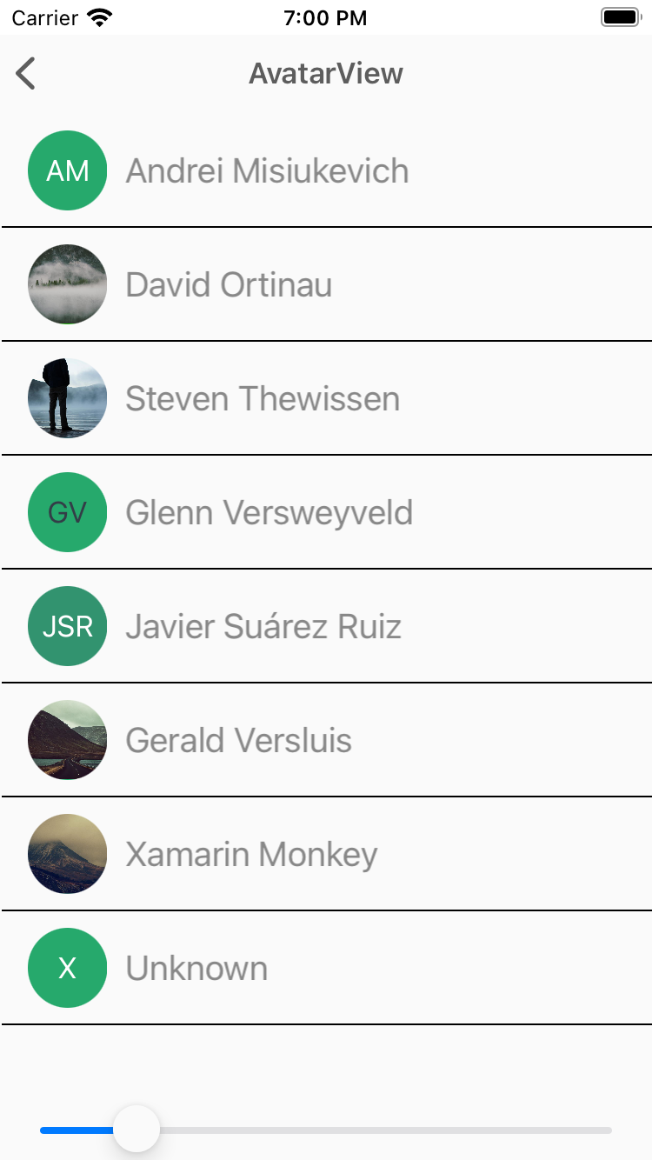
AvatarView
The AvatarView represents a user's name by using the initials and a generated background color.
<xct:AvatarView
ColorTheme="{x:Static xct:ColorTheme.Jungle}"
FontSize="Medium”>
<xct:AvatarView.Source>
<UriImageSource Uri="{Binding Source}" />
</xct:AvatarView.Source>
</xct:AvatarView>

Slide 18
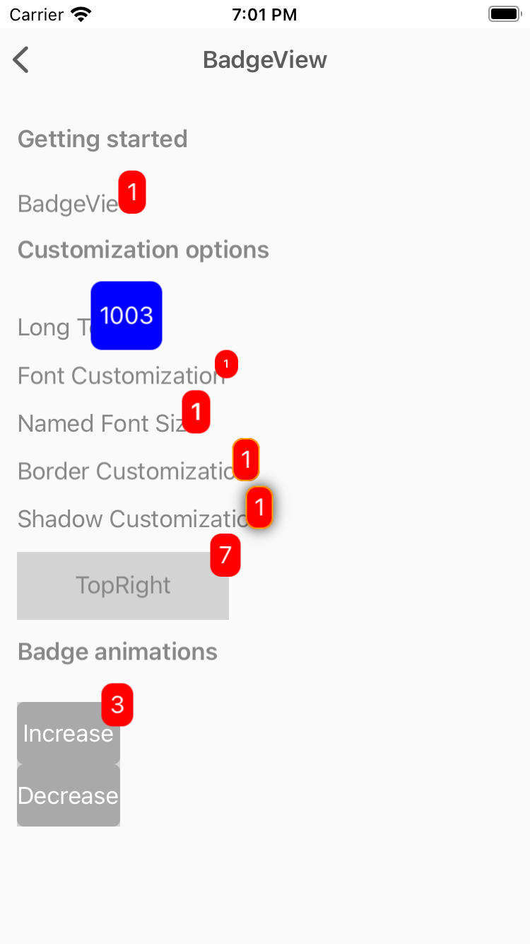
BadgeView
View used to used to notify users notifications, or status of something.
<xct:BadgeView
BackgroundColor="Red"
TextColor="White"
Text="1">
<Label
Text="BadgeView"/>
</xct:BadgeView>

Slide 19
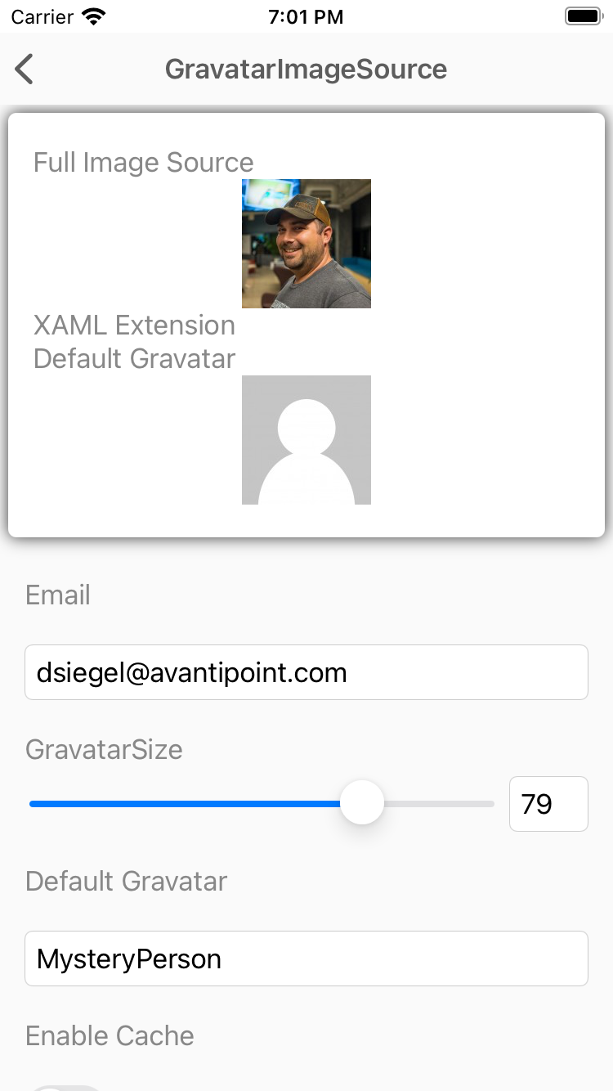
GravatarImageSource
The GravatarImageSource allows you to easily utilize a users Gravatar image from Gravatar.com using nothing but their email address.
<Image>
<Image.Source>
<xct:GravatarImageSource
Email="{Binding Email}"
Size="{Binding Size}"
CachingEnabled="{Binding EnableCache}" />
</Image.Source>
</Image>

Slide 20
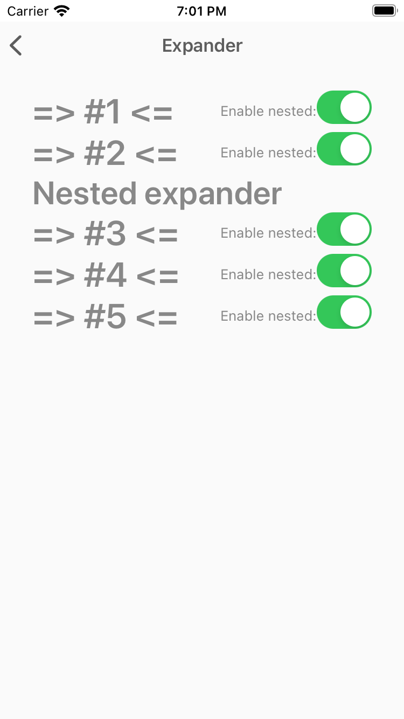
Expander
The Expander control provides an expandable container to host any content.
<xct:Expander IsEnabled="{Binding IsEnabled}">
<xct:Expander.Header>
<Label Text="Nested expander" FontSize="30" FontAttributes="Bold"/>
</xct:Expander.Header>
<xct:Expander.ContentTemplate>
<DataTemplate>
<StackLayout Spacing="0" Margin="10" Padding="1" BackgroundColor="Black">
<BoxView HeightRequest="50" Color="White" />
<BoxView HeightRequest="50" Color="Red" />
<BoxView HeightRequest="50" Color="White" />
</StackLayout>
</DataTemplate>
</xct:Expander.ContentTemplate>
</xct:Expander>

Slide 21
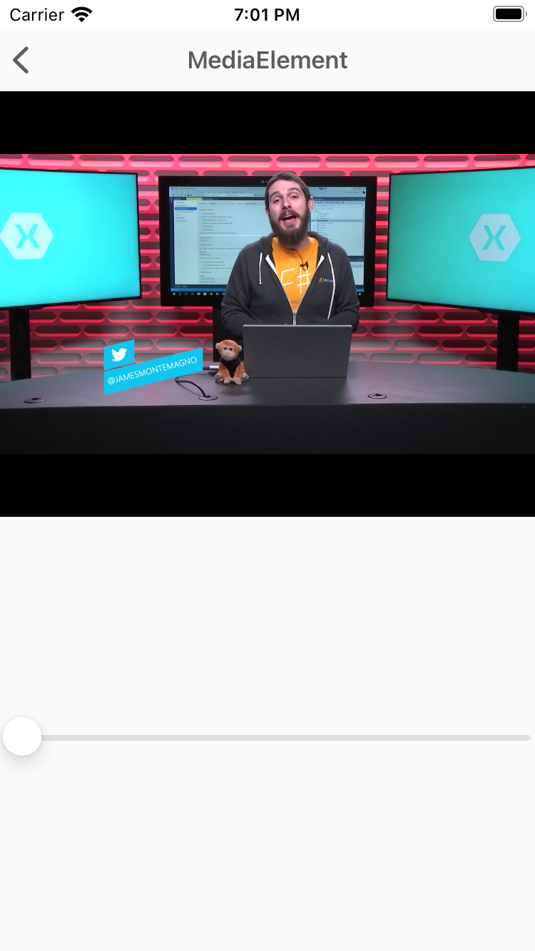
MediaElement
MediaElement is a view for playing video and audio.
<xct:MediaElement
x:Name="mediaElement"
Source="https://sec.ch9.ms/ch9/5d93/a1eab4bf-3288-4faf-81c4-294402a85d93/XamarinShow_mid.mp4"
ShowsPlaybackControls="True"
MediaOpened="OnMediaOpened"
MediaFailed="OnMediaFailed"
MediaEnded="OnMediaEnded"
SeekCompleted="OnSeekCompleted" />

Slide 22
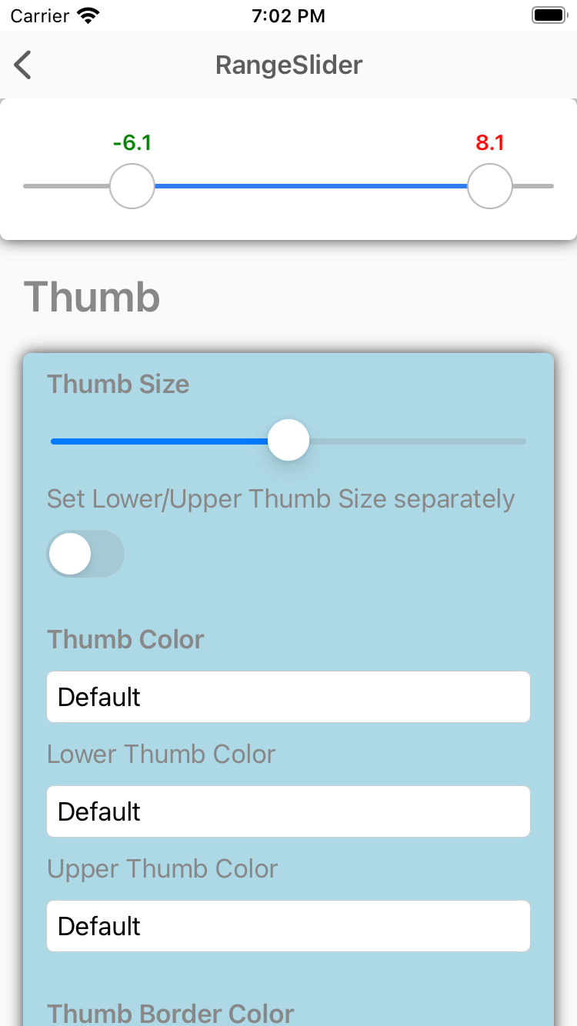
RangeSlider
The RangeSlider is a slider with two thumbs allowing to select numeric ranges.
<xct:RangeSlider
x:Name="RangeSlider"
MaximumValue="10"
MinimumValue="-10"
StepValue="0.01"
LowerValue="-10"
UpperValue="10”>
<xct:RangeSlider.LowerThumbView>
<Label Text="L" VerticalTextAlignment="Center" HorizontalTextAlignment="Center" IsVisible="{Binding IsToggled, Source={x:Reference LowerThumbViewSwitch}}" />
</xct:RangeSlider.LowerThumbView>
<xct:RangeSlider.UpperThumbView>
<Label Text="U" VerticalTextAlignment="Center" HorizontalTextAlignment="Center" IsVisible="{Binding IsToggled, Source={x:Reference UpperThumbViewSwitch}}" />
</xct:RangeSlider.UpperThumbView>
</xct:RangeSlider>

Slide 23
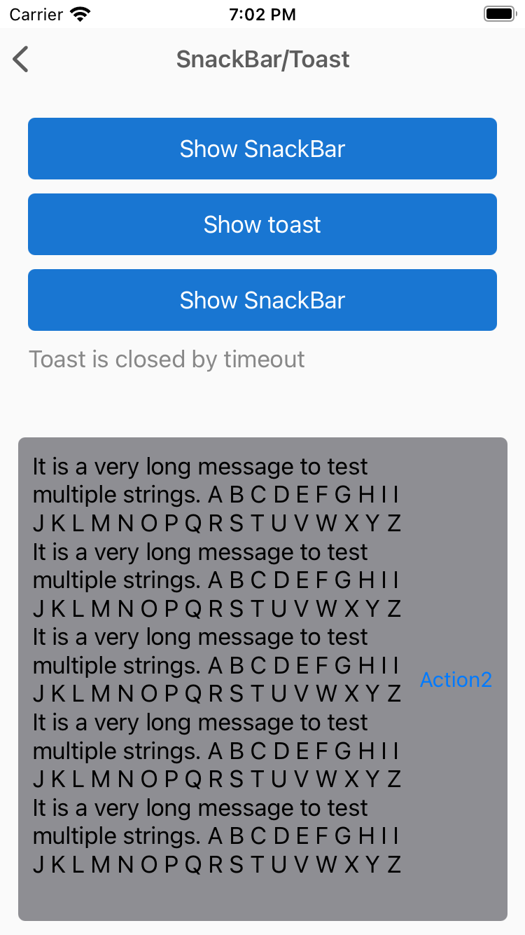
SnackBar
Show SnackBar, Toast etc.
var messageOptions = new MessageOptions
{
Message = GenerateLongText(5)
};
var actionOptions = new List<SnackBarActionOptions>
{
new SnackBarActionOptions
{
Text = "Action1",
Action = () =>
{
Debug.WriteLine("1");
return Task.CompletedTask;
}
},
new SnackBarActionOptions
{
Text = "Action2",
Action = () =>
{
Debug.WriteLine("2");
return Task.CompletedTask;
}
}
};
var options = new SnackBarOptions
{
MessageOptions = messageOptions,
Duration = TimeSpan.FromMilliseconds(5000),
Actions = actionOptions
};
var result = await this.DisplaySnackBarAsync(options);

Slide 24
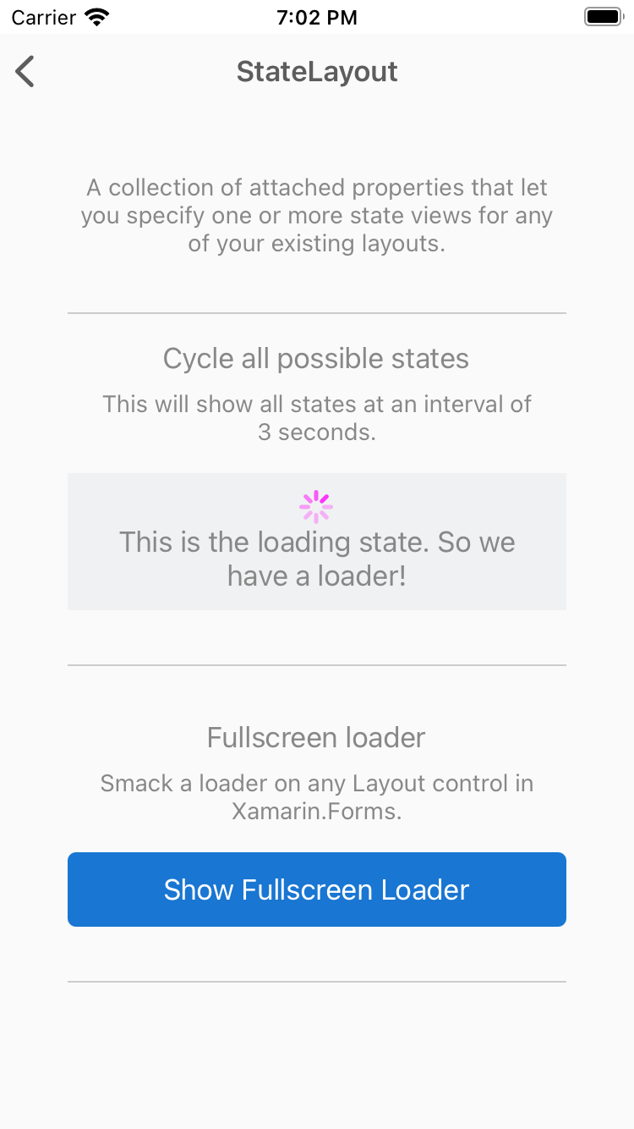
StateLayout
A collection of attached properties that let you specify one or more state views for any of your existing layouts.
<xct:StateLayout.StateViews>
<xct:StateView StateKey="Loading" BackgroundColor="White" VerticalOptions="FillAndExpand">
<StackLayout VerticalOptions="Center" HorizontalOptions="Center">
<ActivityIndicator Color="#1abc9c" IsRunning="{Binding MainState, Converter={StaticResource StateToBooleanConverter}, ConverterParameter={x:Static xct:LayoutState.Loading}}" />
<Label Text="Loading..." HorizontalOptions="Center" />
</StackLayout>
</xct:StateView>
</xct:StateLayout.StateViews>

Slide 25
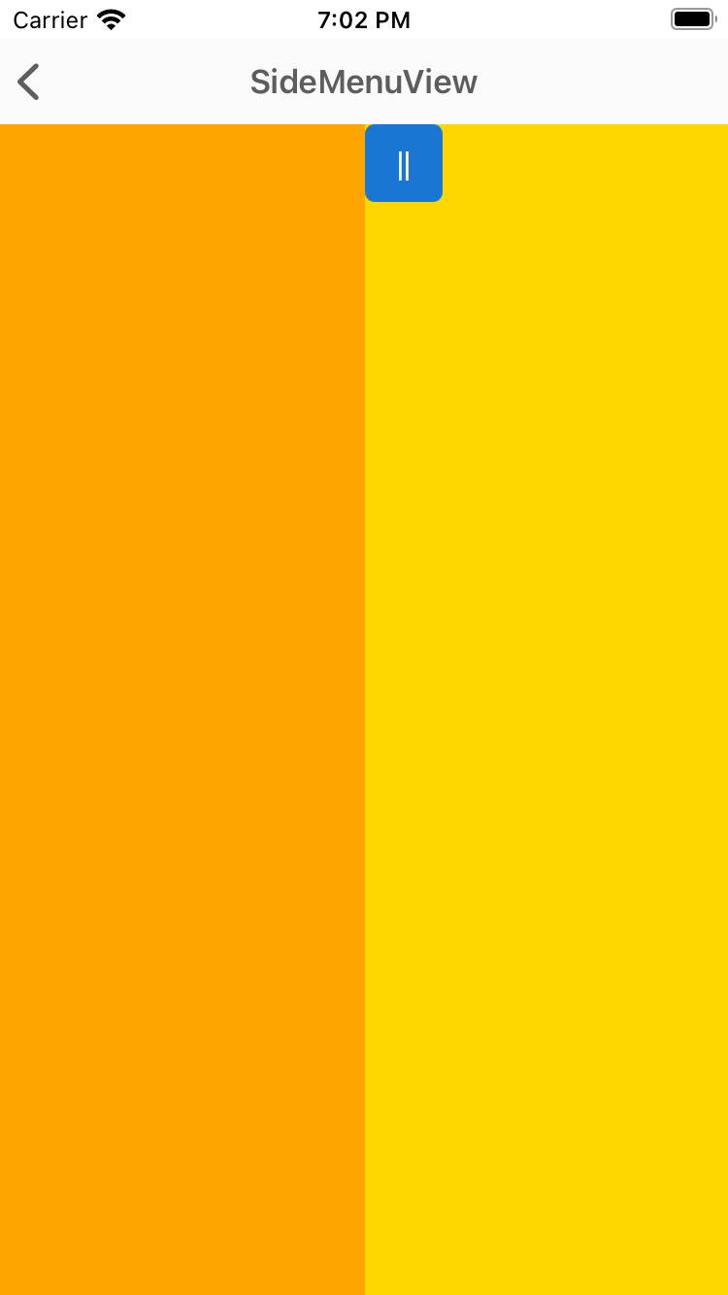
SideMenuView
SideMenuView is a simple and flexible Right/Left menu control.
<xct:SideMenuView x:Name="SideMenuView">
<!-- MainView -->
<StackLayout
Orientation="Horizontal"
BackgroundColor="Gold">
<Button Style="{StaticResource BaseMenuButtonStyle}"
Clicked="OnLeftButtonClicked" />
<Button Style="{StaticResource BaseMenuButtonStyle}"
HorizontalOptions="EndAndExpand"
Clicked="OnRightButtonClicked" />
</StackLayout>
<!-- LeftMenu -->
<BoxView
BackgroundColor="Orange"
xct:SideMenuView.Position="LeftMenu"
xct:SideMenuView.MenuWidthPercentage=".5" />
<!-- RightMenu -->
<BoxView
BackgroundColor="LightGreen"
xct:SideMenuView.Position="RightMenu"
xct:SideMenuView.MenuWidthPercentage=".3" />
</xct:SideMenuView>

Slide 26
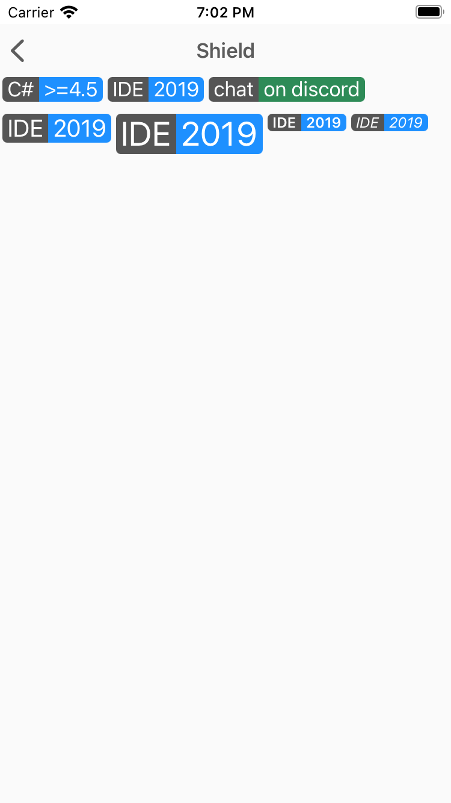
Shield
Shields can show some status information or call-to-action in a badge-like way.
<xct:Shield
Subject="IDE"
Status="2019"
Color="DodgerBlue"
TextColor="White"
Margin="2,0" />

Slide 27
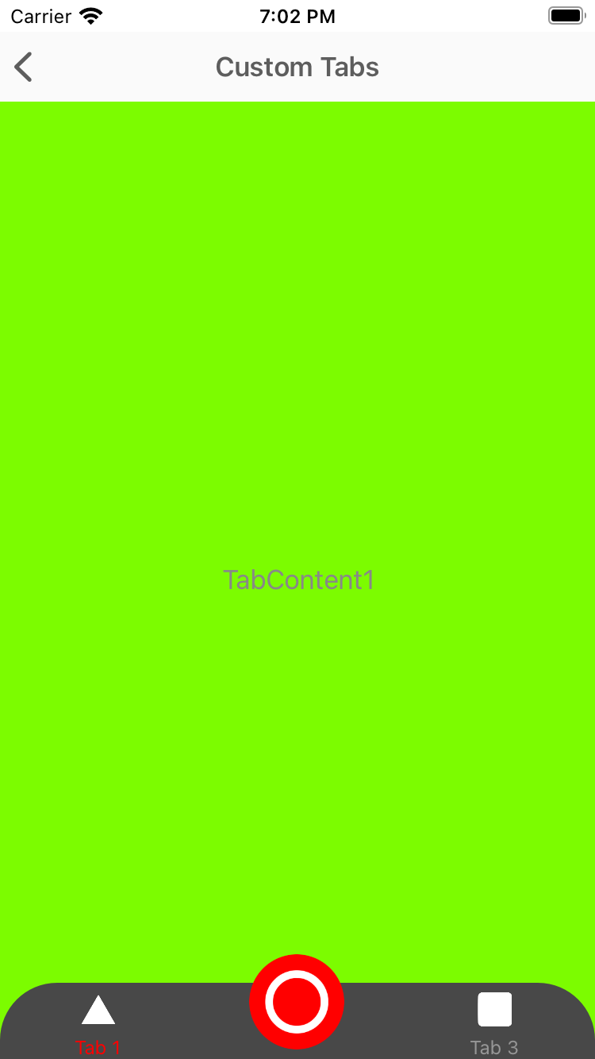
TabView
Shields can show some status information or call-to-action in a badge-like way.
<xct:TabView
TabStripPlacement="Bottom"
TabStripBackgroundColor="Blue"
TabStripHeight="60"
TabIndicatorColor="Yellow"
TabContentBackgroundColor="Yellow">
<xct:TabViewItem
Icon="triangle.png"
Text="Tab 1"
TextColor="White"
TextColorSelected="Yellow"
FontSize="12">
<Grid
BackgroundColor="Gray">
<Label
HorizontalOptions="Center"
VerticalOptions="Center"
Text="TabContent1" />
</Grid>
</xct:TabViewItem>
<xct:TabViewItem
Icon="circle.png"
Text="Tab 2"
TextColor="White"
TextColorSelected="Yellow"
FontSize="12">
<Grid>
<Label
HorizontalOptions="Center"
VerticalOptions="Center"
Text="TabContent2" />
</Grid>
</xct:TabViewItem>
</xct:TabView>

Slide 28
DEMO: Let's take a look at the controls

Slide 29
¿How to use the XCT?
The toolkit is available via NuGet, and should be installed into all your projects:
The Xamarin Comunity Toolkit also include C# markup.
C# markup is an opt-in set of fluent helper methods and classes to simplify the process of building declarative Xamarin.Forms user interfaces in C#. The fluent API provided by C# markup is available in the Xamarin.CommunityToolkit.Markup NuGet package.
Install-Package Xamarin.CommunityToolkit -Version 1.0.0-pre5
Install-Package Xamarin.CommunityToolkit.Markup -Version 1.0.0-pre5

Slide 30
C# Markup
C# markup is an opt-in set of fluent helper methods and classes to simplify the process of building declarative Xamarin.Forms user interfaces in C#.
View Build() => new Grid
{
RowDefinitions = Rows.Define(
(BodyRow.Prompt , 170 ),
(BodyRow.CodeHeader, 75 ),
(BodyRow.CodeEntry , Auto),
(BodyRow.Button , Auto)
),
ColumnDefinitions = Columns.Define(
(BodyCol.FieldLabel , 160 ),
(BodyCol.FieldValidation, Star)
),
Children =
{
new Label { LineBreakMode = LineBreakMode.WordWrap } .Font (15) .Bold ()
.Row (BodyRow.Prompt) .ColumnSpan (All<BodyCol>()) .FillExpandHorizontal () .CenterVertical () .Margin (fieldNameMargin) .TextCenterHorizontal ()
.Bind (nameof(vm.RegistrationPrompt)),
new Label { Text = "Registration code" } .Bold ()
.Row (BodyRow.CodeHeader) .Column(BodyCol.FieldLabel) .Bottom () .Margin (fieldNameMargin),
new Label { } .Italic ()
.Row (BodyRow.CodeHeader) .Column (BodyCol.FieldValidation) .Right () .Bottom () .Margin (fieldNameMargin)
.Bind (nameof(vm.RegistrationCodeValidationMessage)),
new Entry { Placeholder = "E.g. 123456", Keyboard = Keyboard.Numeric, BackgroundColor = Color.AliceBlue, TextColor = Color.Black } .Font (15)
.Row (BodyRow.CodeEntry) .ColumnSpan (All<BodyCol>()) .Margin (fieldMargin) .Height (44)
.Bind (nameof(vm.RegistrationCode), BindingMode.TwoWay),
new Button { Text = "Verify" } .Style (FilledButton)
.Row (BodyRow.Button) .ColumnSpan (All<BodyCol>()) .FillExpandHorizontal () .Margin (PageMarginSize)
.Bind (Button.IsVisibleProperty, nameof(vm.CanVerifyRegistrationCode))
.Bind (nameof(vm.VerifyRegistrationCodeCommand)),
}
};

Slide 31
What's next?

Slide 32
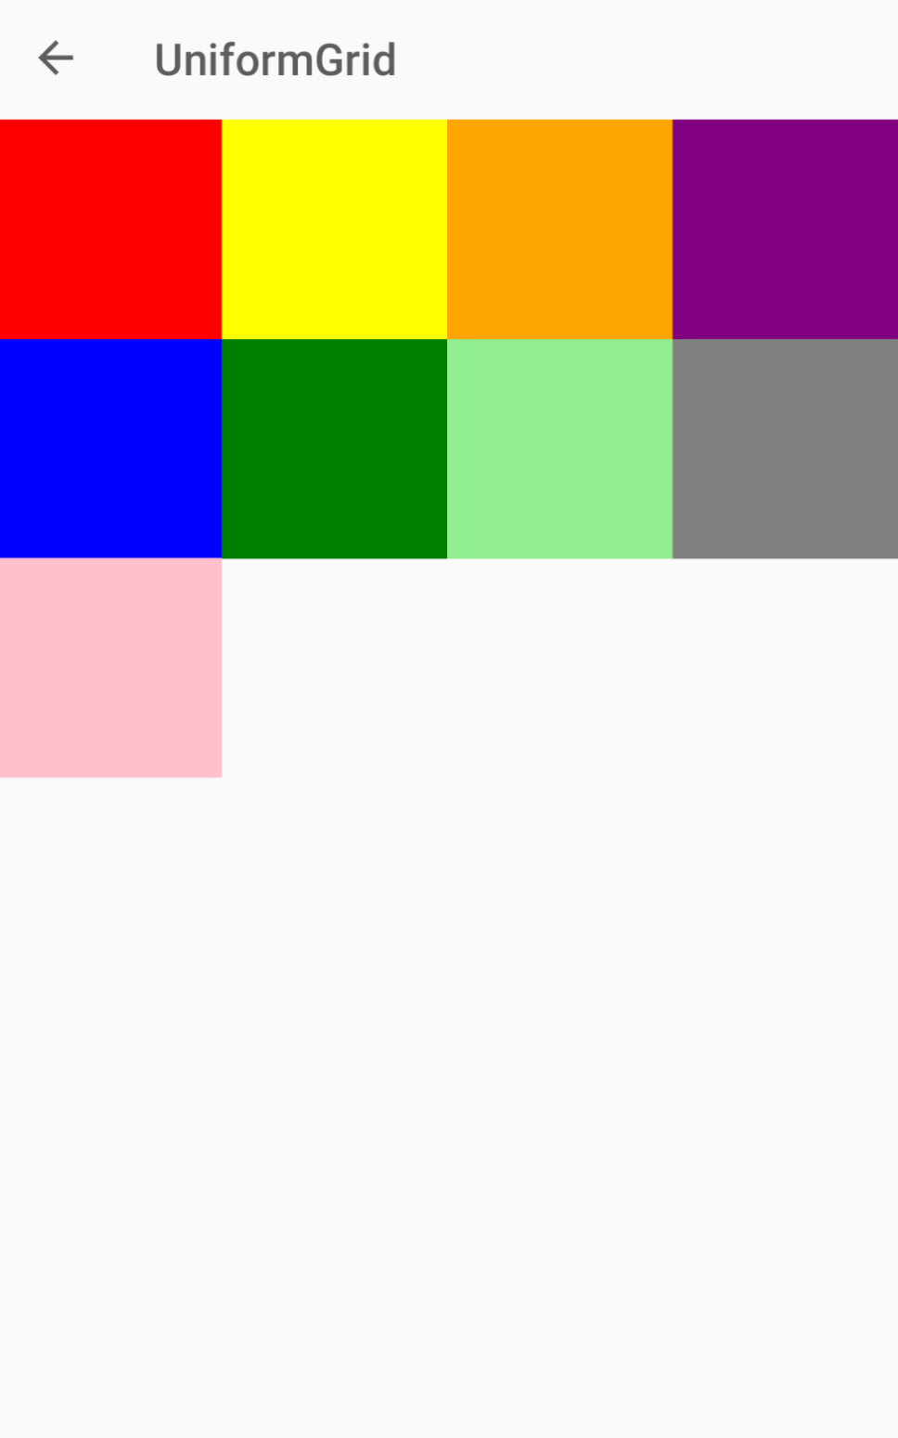
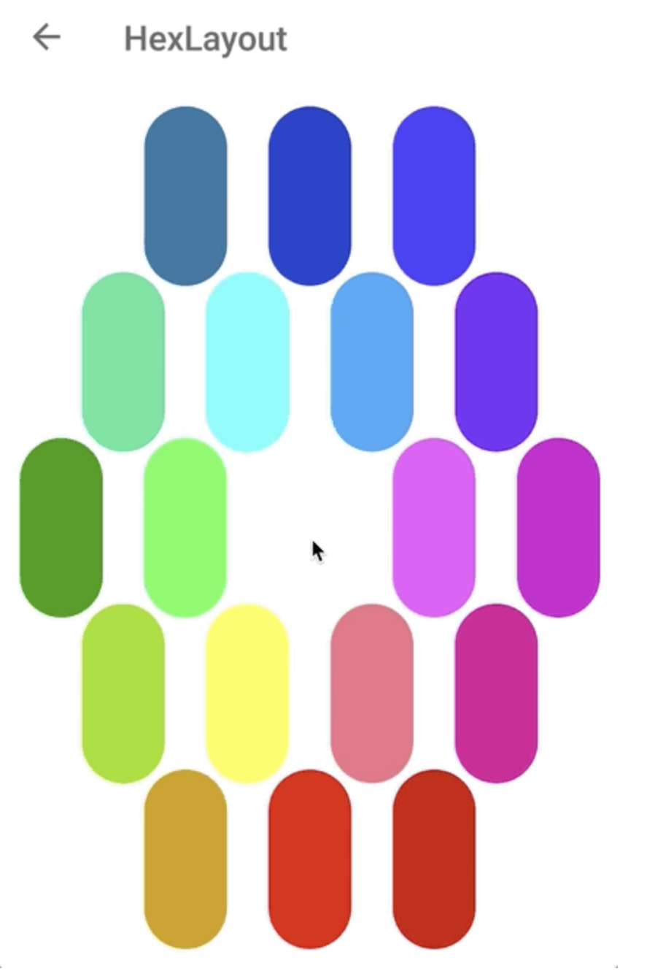
What's next?
Popups!
ContentButton
Layouts like:
UniformGrid
HexLayout
DockLayout
An much more!

Slide 33
Let’s see how to collaborate with the XCT

Slide 34




























#monkeyconf
Thanks to the Community!

Slide 35
Questions?

Slide 36


